Slide 1
Key Recovery Attack on The Cubic ABC Simple-Matrix Encryption Scheme
Dustin Moody, Ray Perlner, Daniel Smith-Tone

Slide 2
Outline
Multivariate Cryptography
Cubic ABC
Differential Structure (Band Spaces and Band Kernels)
Finding the Structure
Extending the attack to a full Key Recovery
Conclusion

Slide 3
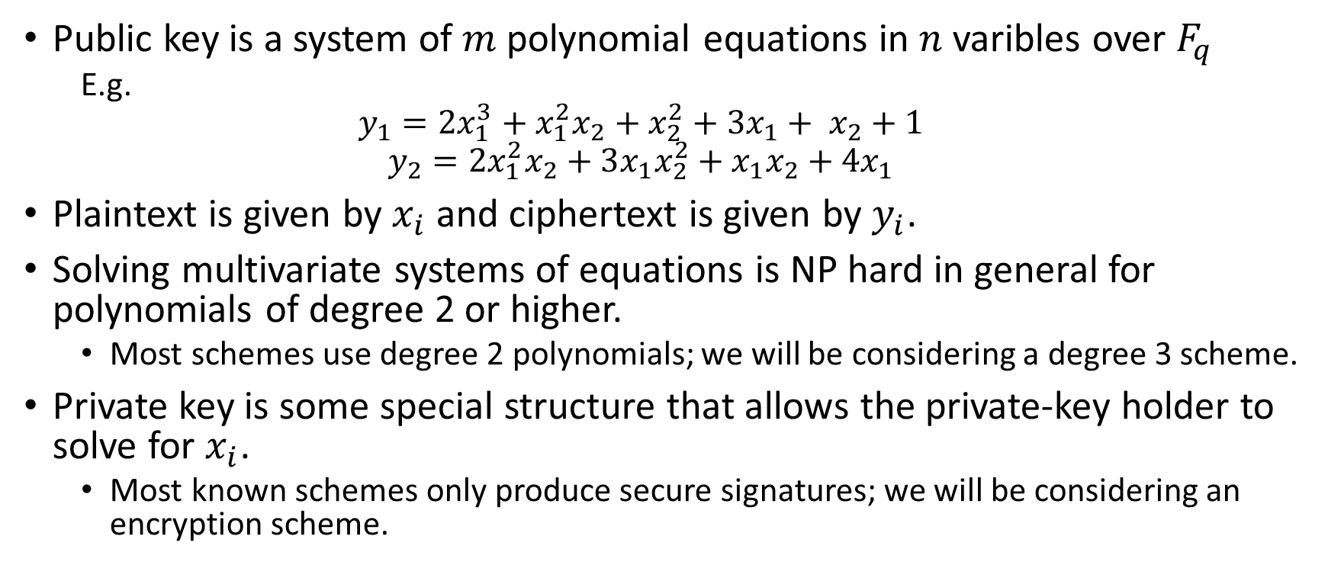
Multivariate cryptography
Public key is a system of $m$ polynomial equations in $n$ varibles over $F_{q}$
  E.g.
  $$y_{1}=2x_{1}^{3}+x_{1}^{2}x_{2}+x_{2}^{2}+3x_{1}+ x_{2}+1$$
  $$y_{2}=2x_{1}^{2}x_{2}+3x_{1}x_{2}^{2}+x_{1}x_{2}+4x_{1}$$
Plaintext is given by $x_{i}$ and ciphertext is given by $y_{i}$.
Solving multivariate systems of equations is NP hard in general for polynomials of degree 2 or higher.
  Most schemes use degree 2 polynomials; we will be considering a degree 3 scheme.
Private key is some special structure that allows the private-key holder to solve for $x_{i}$.
  Most known schemes only produce secure signatures; we will be considering an encryption scheme.

Slide 4
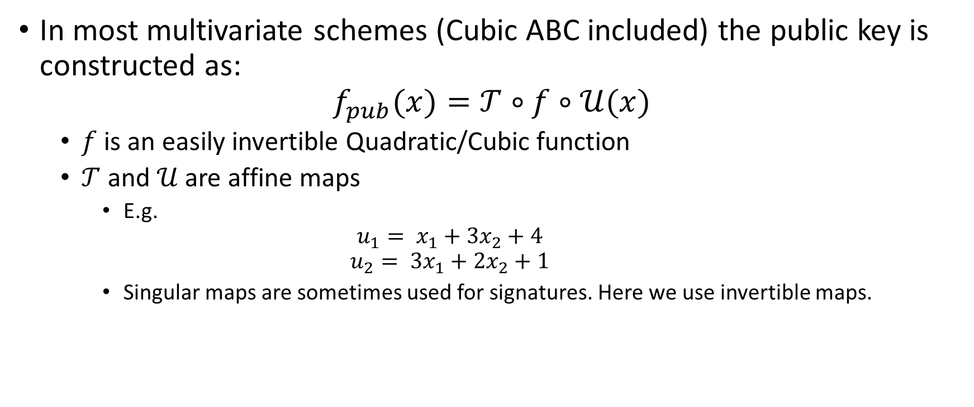
Multivariate Cryptography 2
The Butterfly Construction
In most multivariate schemes (Cubic ABC included) the public key is constructed as:
$$f_{pub}(x)=𝒯∘f∘𝒰(x)$$
  $f$ is an easily invertible Quadratic/Cubic function
  $𝒯$ and $𝒰$ are affine maps
    E.g.
    $$u_{1}= x_{1}+3x_{2}+4$$
    $$u_{2}= {3x}_{1}+2x_{2}+1$$
    Singular maps are sometimes used for signatures. Here we use invertible maps.

Slide 5

Cubic ABC: The Core Map
Central map is $s^{2}→2s^{2}$ function where the equations are grouped as the elements of two matrices $f\left(\vec{x}\right)=\left(E_{1}\left(\vec{x}\right), E_{2}\left(\vec{x}\right)\right)$
  $E_{1}=AB; E_{2}=AC$
  $b_{i}$,$c_{i}$ are linear functions of $\vec{x}$.
  $p_{i}$ are quadratic functions of $\vec{x}$.
Decryption proceeds by solving:
${(A(\vec{x}))}^{−1}E_{1}=B\left(\vec{x}\right)$
${(A(\vec{x}))}^{−1}E_{2}=C\left(\vec{x}\right)$
for ${(A(\vec{x}))}^{−1}$ and $\vec{x}$. (Linear)

Slide 6
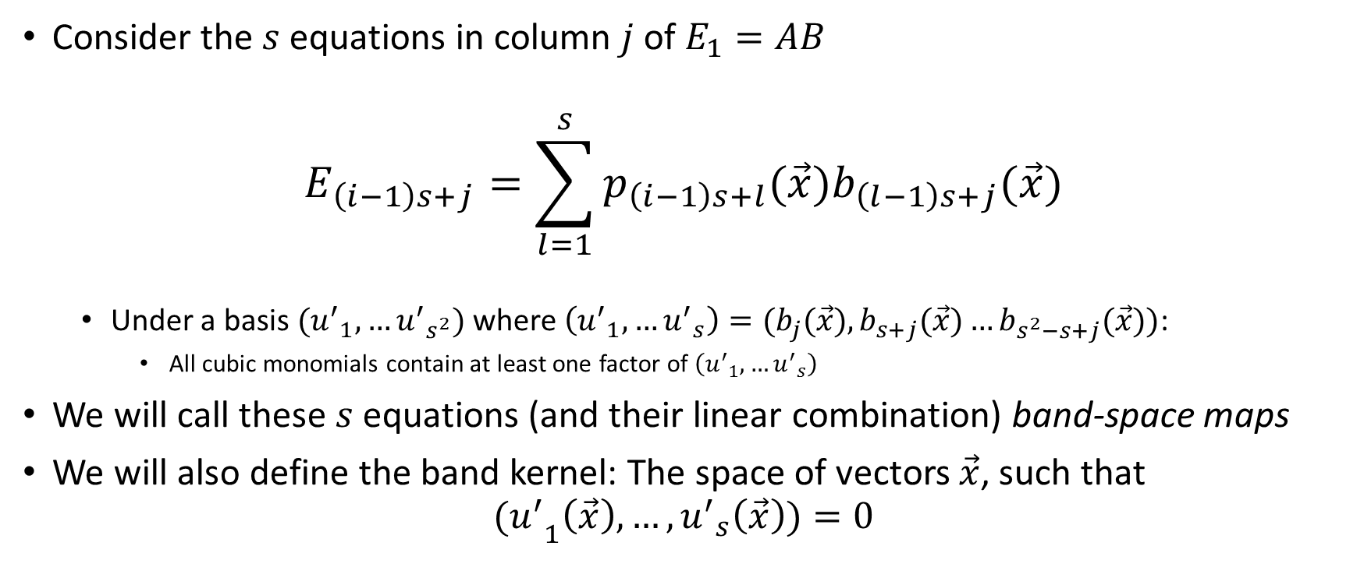
Special Structure: Band Spaces
  Consider the $s$ equations in column $j$ of $E_{1}=AB$
$$E_{\left(i−1\right)s+j}=\sum_{l=1}^{s}{p_{\left(i−1\right)s+l}(\vec{x})b_{\left(l−1\right)s+j}(\vec{x})}$$
  Under a basis $({u^{′}}_{1}, …{u^{′}}_{s^{2}})$ where $\left({u^{′}}_{1}, …{u^{′}}_{s}\right)=(b_{j}(\vec{x}),b_{s+j}(\vec{x})…b_{s^{2}−s+j}(\vec{x}))$:
    All cubic monomials contain at least one factor of $\left({u^{′}}_{1}, …{u^{′}}_{s}\right)$
We will call these $s$ equations (and their linear combination) band-space maps
We will also define the band kernel: The space of vectors $\vec{x}$, such that
$${(u^{′}}_{1}\left(\vec{x}\right),…,{u^{′}}_{s}\left(\vec{x}\right))=0$$

Slide 7

How many band spaces are there:
Not only do the columns of $E_{1}=AB$ and $E_{2}=AC$ define band spaces, but fixed linear combinations of the columns $(\vec{β},\vec{γ})$ do as well.
  Band Space:
  Band Kernel:
  ($x∈{ℬ𝒦}_{β,γ}$)

Slide 8
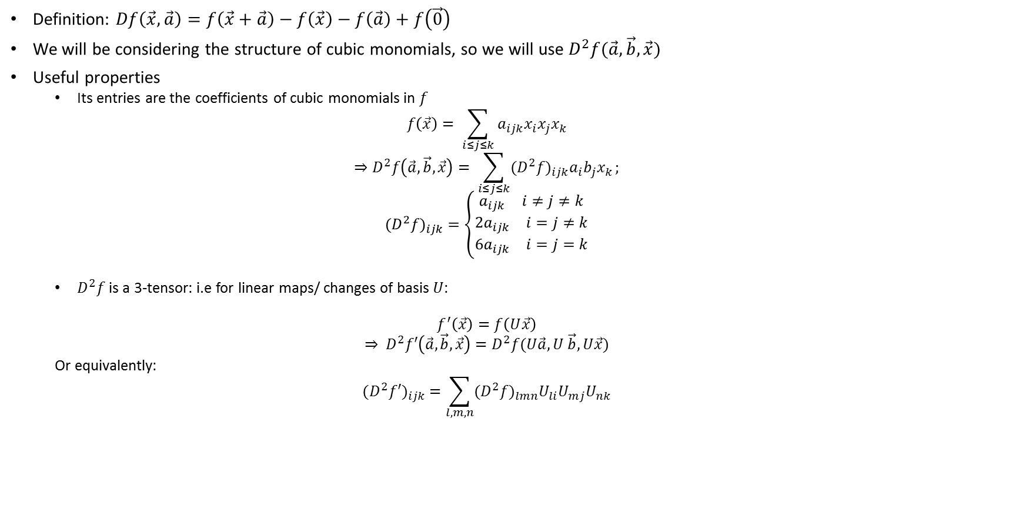
A Formal Tool for Describing the Structure:
The Discrete Differential
Definition: $Df\left(\vec{x},\vec{a}\right)=f\left(\vec{x}+\vec{a}\right)−f\left(\vec{x}\right)−f\left(\vec{a}\right)+f\left(\vec{0}\right)$
We will be considering the structure of cubic monomials, so we will use $D^{2}f(\vec{a},\vec{b},\vec{x})$
Useful properties
  Its entries are the coefficients of cubic monomials in $f$
  $$f\left(\vec{x}\right)= \sum_{i≤j≤k}{a_{ijk}x_{i}x_{j}x_{k}}$$
  $$⇒D^{2}f\left(\vec{a},\vec{b},\vec{x}\right)= \sum_{i≤j≤k}{({D^{2}f)}_{ijk}a_{i}b_{j}x_{k}};$$
  $${{(D}^{2}f)}_{ijk}=\left\{\begin{matrix}\begin{matrix}a_{ijk} & i≠j≠k\end{matrix} \\ \begin{matrix}{2a}_{ijk} & i=j≠k\end{matrix} \\ \begin{matrix}{6a}_{ijk} & i=j=k\end{matrix}\end{matrix}\right.$$
  $D^{2}f$ is a 3-tensor: i.e for linear maps/ changes of basis $U$:
  $$f^{′}\left(\vec{x}\right)=f\left(U\vec{x}\right)$$
  $$⇒ D^{2}f′\left(\vec{a},\vec{b},\vec{x}\right)=D^{2}f(U\vec{a},U \vec{b}, U\vec{x})$$
  Or equivalently:
  $${{(D}^{2}f′)}_{ijk}=\sum_{l,m,n}{{{(D}^{2}f)}_{lmn}U_{li}U_{mj}U_{nk}}$$

Slide 9
The (2nd) Differential Form of Band-Space Maps

Slide 10
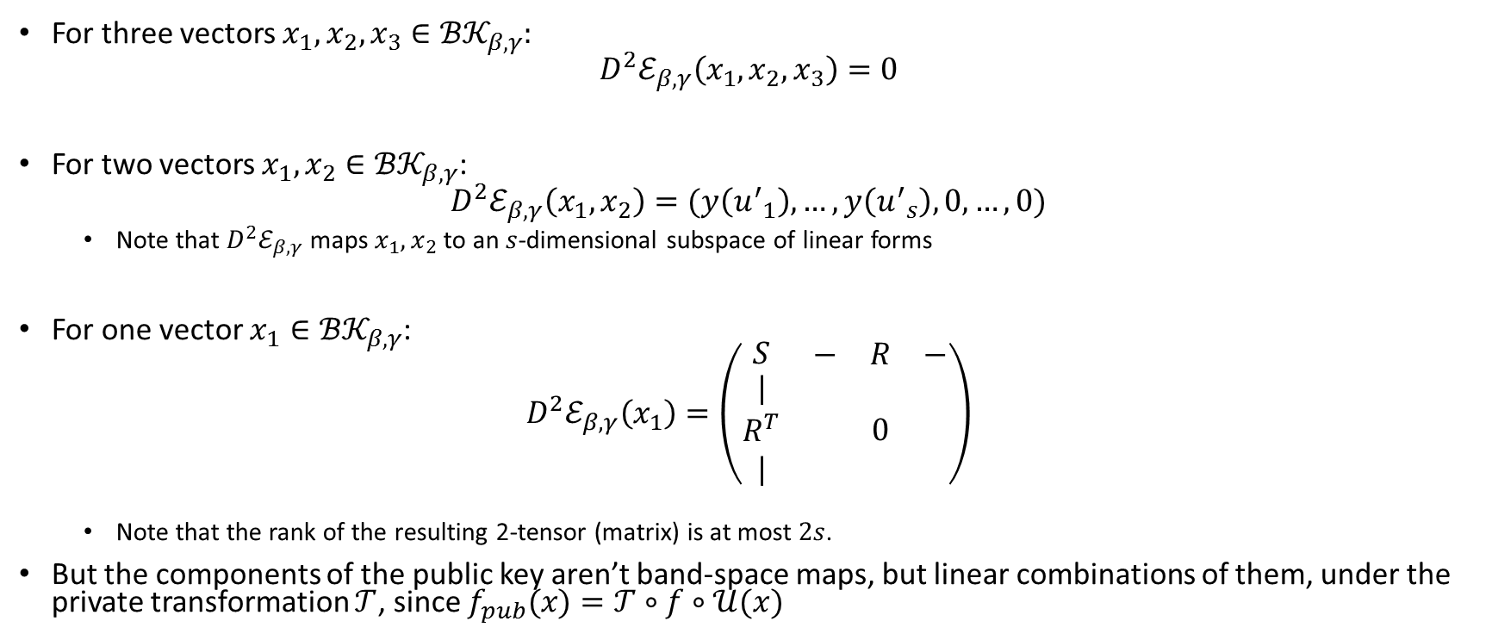

Some properties of band-space differentials.
(in the ${u′}_{i}$ basis)
For three vectors $x_{1}, x_{2},x_{3}∈{ℬ𝒦}_{β,γ}$:
$$D^{2}ℰ_{β,γ}\left(x_{1},x_{2},x_{3}\right)=0$$
For two vectors $x_{1}, x_{2}∈{ℬ𝒦}_{β,γ}$:
$$D^{2}ℰ_{β,γ}\left(x_{1},x_{2}\right)=(y\left({u^{′}}_{1}\right), …,y\left({u^{′}}_{s}\right),0,…,0)$$
  Note that $D^{2}ℰ_{β,γ}$ maps $x_{1}, x_{2}$ to an $s$-dimensional subspace of linear forms
For one vector $x_{1}∈{ℬ𝒦}_{β,γ}$:
$$D^{2}ℰ_{β,γ}\left(x_{1}\right)=\left(\begin{matrix}S & \begin{matrix}− & R & −\end{matrix} \\ \begin{matrix}| \\ R^{T} \\ |\end{matrix} & 0\end{matrix}\right)$$
  Note that the rank of the resulting 2-tensor (matrix) is at most $2s$.
But the components of the public key aren’t band-space maps, but linear combinations of them, under the private transformation $𝒯$, since $f_{pub}(x)=𝒯∘f∘𝒰(x)$

Slide 11
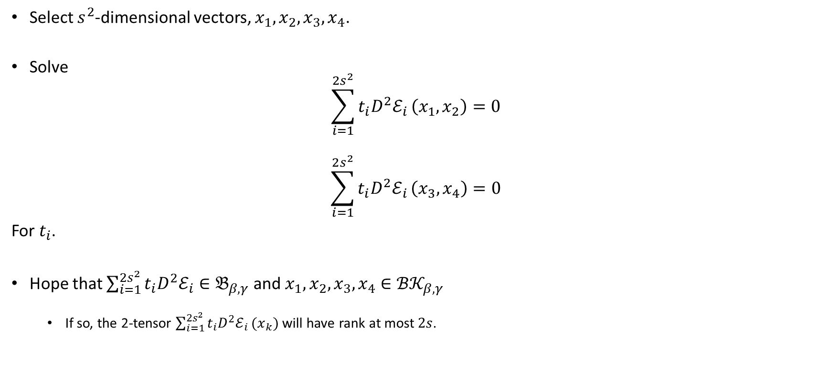
Our attack strategy
(Modified MinRank)
Select $s^{2}$-dimensional vectors, $x_{1},x_{2},x_{3},x_{4}$.
Solve
$$\sum_{i=1}^{2s^{2}}{t_{i}D^{2}ℰ_{i}}\left(x_{1},x_{2}\right)=0$$
$$\sum_{i=1}^{2s^{2}}{t_{i}D^{2}ℰ_{i}}\left(x_{3},x_{4}\right)=0$$
For $t_{i}$.
Hope that $\sum_{i=1}^{2s^{2}}{t_{i}D^{2}ℰ_{i}}∈𝔅_{β,γ}$ and $x_{1},x_{2},x_{3},x_{4}∈{ℬ𝒦}_{β,γ}$
  If so, the 2-tensor $\sum_{i=1}^{2s^{2}}{t_{i}D^{2}ℰ_{i}}(x_{k})$ will have rank at most $2s$.

Slide 12
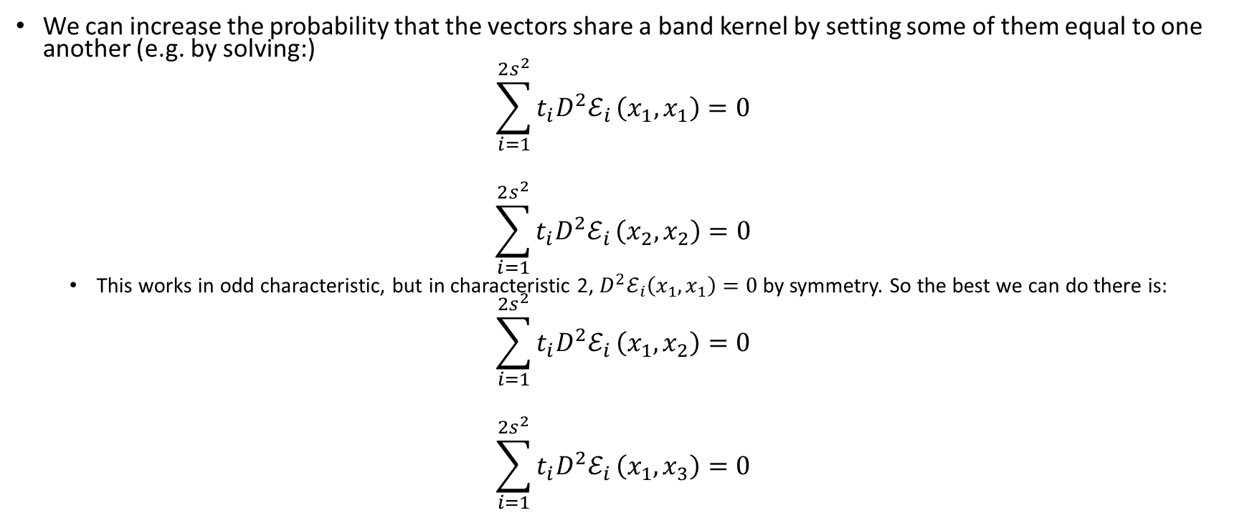
Setting some vectors equal
We can increase the probability that the vectors share a band kernel by setting some of them equal to one another (e.g. by solving:)
$$\sum_{i=1}^{2s^{2}}{t_{i}D^{2}ℰ_{i}}\left(x_{1},x_{1}\right)=0$$
$$\sum_{i=1}^{2s^{2}}{t_{i}D^{2}ℰ_{i}}\left(x_{2},x_{2}\right)=0$$
  This works in odd characteristic, but in characteristic 2, $D^{2}ℰ_{i}\left(x_{1},x_{1}\right)=0$ by symmetry. So the best we can do there is:
$$\sum_{i=1}^{2s^{2}}{t_{i}D^{2}ℰ_{i}}\left(x_{1},x_{2}\right)=0$$
$$\sum_{i=1}^{2s^{2}}{t_{i}D^{2}ℰ_{i}}\left(x_{1},x_{3}\right)=0$$

Slide 13
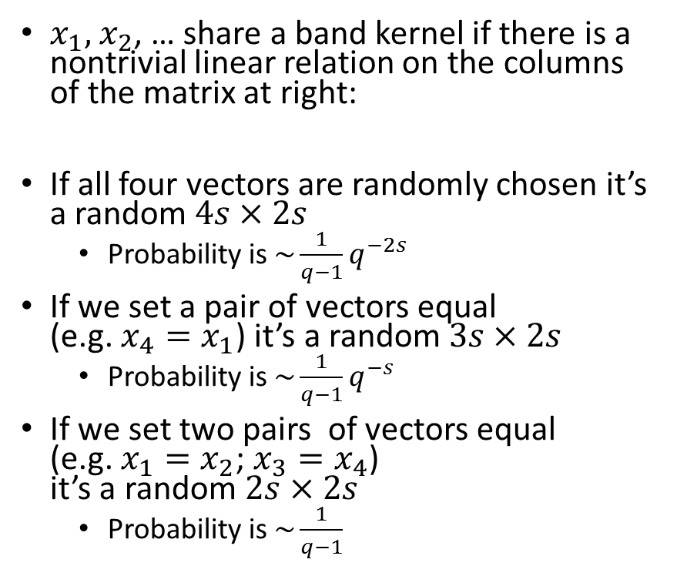
How likely are random vectors to share a band kernel?
$x_{1},$ $x_{2}$, … share a band kernel if there is a nontrivial linear relation on the columns of the matrix at right:
If all four vectors are randomly chosen it’s a random $4s×2s$
  Probability is $\sim {\frac{1}{q−1}q}^{−2s}$
If we set a pair of vectors equal (e.g. $x_{4}=x_{1}$) it’s a random $3s×2s$
  Probability is $\sim {\frac{1}{q−1}q}^{−s}$
If we set two pairs of vectors equal (e.g. $x_{1}=x_{2}$; $x_{3}=x_{4}$) it’s a random $2s×2s$
  Probability is $\sim \frac{1}{q−1}$

Slide 14
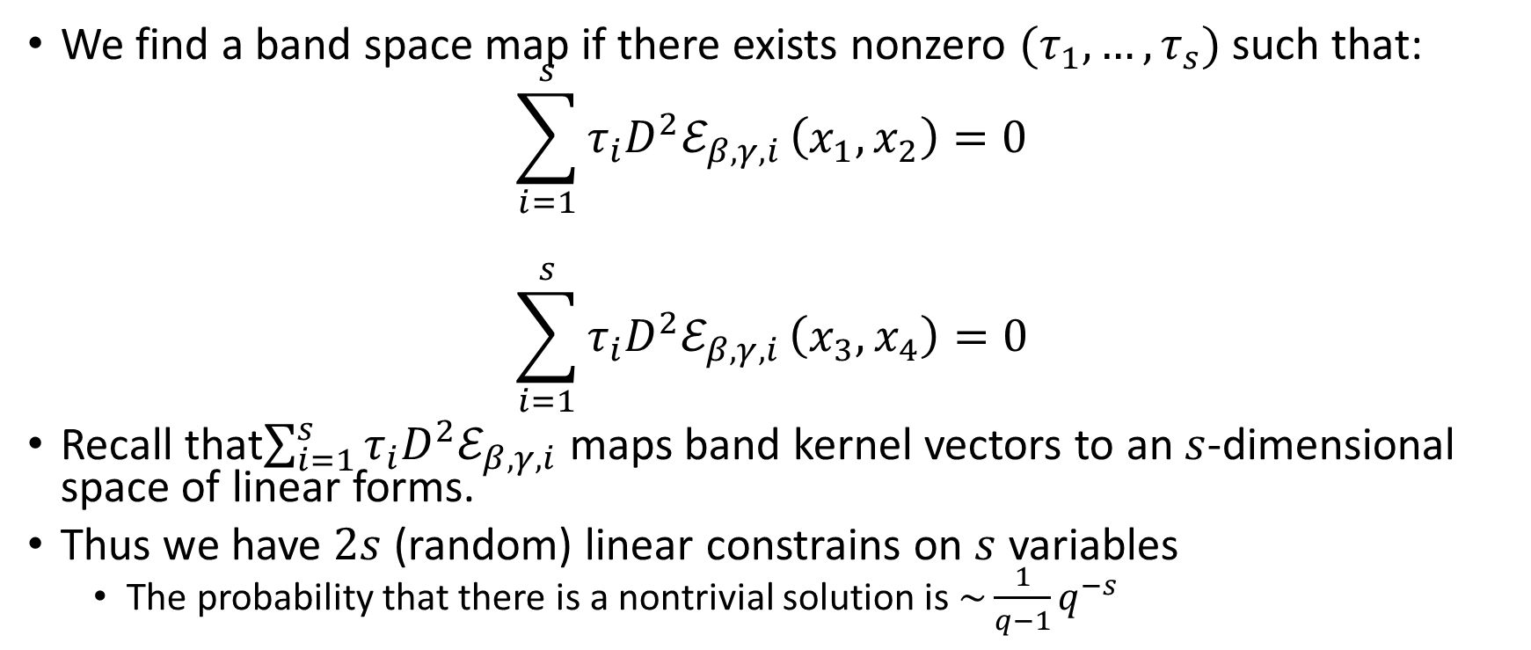
If the vectors share a band kernel, how likely are we to find a band-space map?
We find a band space map if there exists nonzero $(τ_{1},…, τ_{s})$ such that:
$$\sum_{i=1}^{s}{τ_{i}D^{2}ℰ_{β,γ,i}}\left(x_{1},x_{2}\right)=0$$
$$\sum_{i=1}^{s}{τ_{i}D^{2}ℰ_{β,γ,i}}\left(x_{3},x_{4}\right)=0$$
Recall that$\sum_{i=1}^{s}{τ_{i}D^{2}ℰ_{β,γ,i}}$ maps band kernel vectors to an $s$-dimensional space of linear forms.
Thus we have $2s$ (random) linear constrains on $s$ variables
  The probability that there is a nontrivial solution is $\sim {\frac{1}{q−1}q}^{−s}$

Slide 15
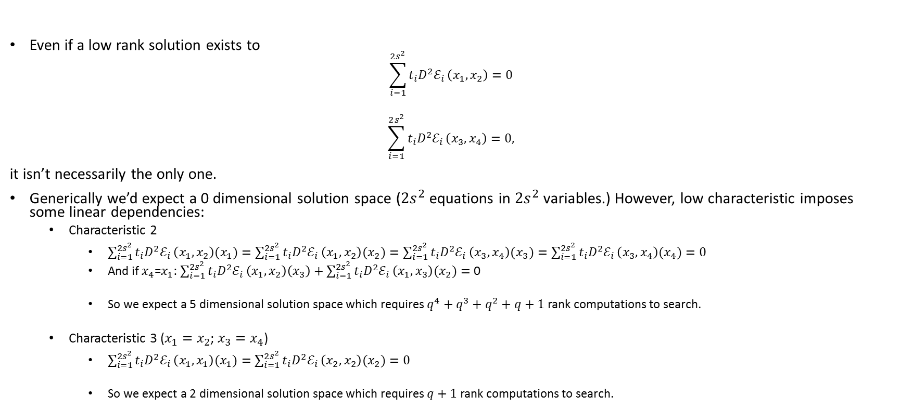
How big a space of solutions do we have to search through
Even if a low rank solution exists to
$$\sum_{i=1}^{2s^{2}}{t_{i}D^{2}ℰ_{i}}\left(x_{1},x_{2}\right)=0$$
$$\sum_{i=1}^{2s^{2}}{t_{i}D^{2}ℰ_{i}}\left(x_{3},x_{4}\right)=0,$$
it isn’t necessarily the only one.
Generically we’d expect a 0 dimensional solution space ($2s^{2}$ equations in $2s^{2}$ variables.) However, low characteristic imposes some linear dependencies:
  Characteristic 2
    $\sum_{i=1}^{2s^{2}}{t_{i}D^{2}ℰ_{i}}\left(x_{1},x_{2}\right)(x_{1})=\sum_{i=1}^{2s^{2}}{t_{i}D^{2}ℰ_{i}}\left(x_{1},x_{2}\right)(x_{2})=\sum_{i=1}^{2s^{2}}{t_{i}D^{2}ℰ_{i}}\left(x_{3},x_{4}\right)(x_{3})=\sum_{i=1}^{2s^{2}}{t_{i}D^{2}ℰ_{i}}\left(x_{3},x_{4}\right)(x_{4})=0$
    And if $x_{4}$=$x_{1}$: $\sum_{i=1}^{2s^{2}}{t_{i}D^{2}ℰ_{i}}\left(x_{1},x_{2}\right)\left(x_{3}\right)+\sum_{i=1}^{2s^{2}}{t_{i}D^{2}ℰ_{i}}\left(x_{1},x_{3}\right)(x_{2})=$ 0
    So we expect a 5 dimensional solution space which requires $q^{4}+q^{3}+q^{2}+q+1$ rank computations to search.
  Characteristic 3 ($x_{1}=x_{2}$; $x_{3}=x_{4}$)
    $\sum_{i=1}^{2s^{2}}{t_{i}D^{2}ℰ_{i}}\left(x_{1},x_{1}\right)(x_{1})=\sum_{i=1}^{2s^{2}}{t_{i}D^{2}ℰ_{i}}\left(x_{2},x_{2}\right)(x_{2})=0$
    So we expect a 2 dimensional solution space which requires $q+1$ rank computations to search.

Slide 16
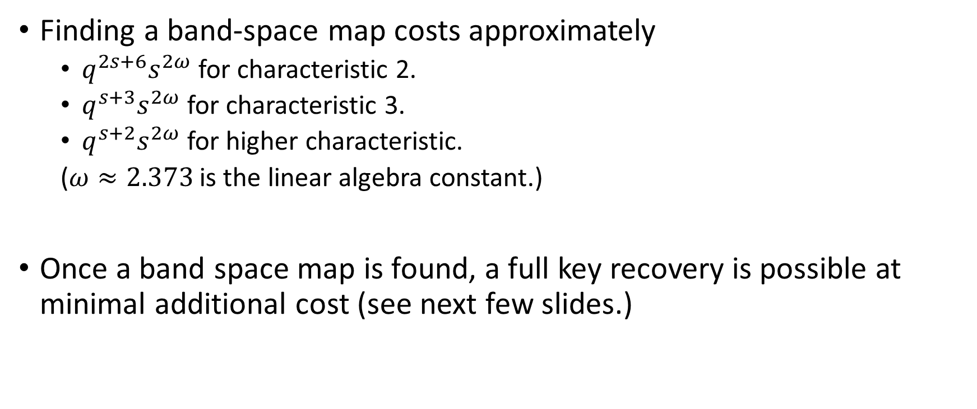
Putting it all together
Finding a band-space map costs approximately
  $q^{2s+6}s^{2ω}$ for characteristic 2.
  $q^{s+3}s^{2ω}$ for characteristic 3.
  $q^{s+2}s^{2ω}$ for higher characteristic.
  ($ω≈2.373$ is the linear algebra constant.)
Once a band space map is found, a full key recovery is possible at minimal additional cost (see next few slides.)

Slide 17
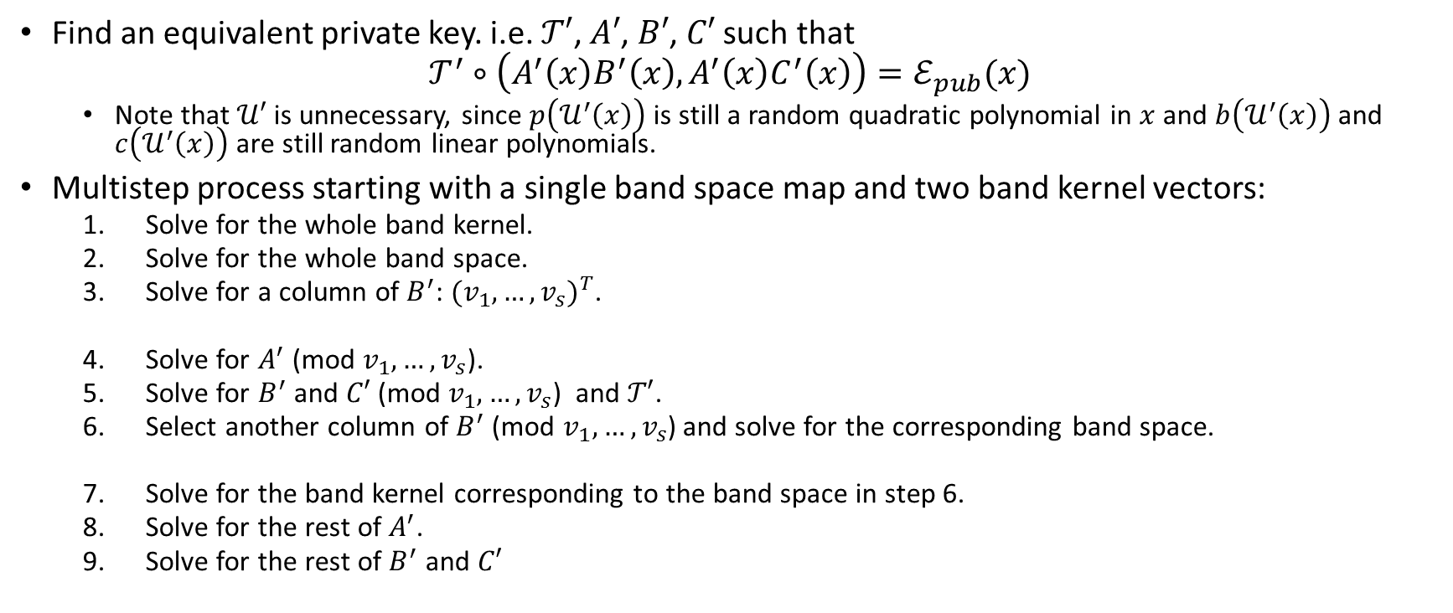
Key Recovery: Overall Strategy
Find an equivalent private key. i.e. $𝒯′$, $A′$, $B′$, $C′$ such that
$$𝒯^{′}∘\left(A^{′}\left(x\right)B^{′}\left(x\right), A^{′}\left(x\right)C^{′}\left(x\right)\right)=ℰ_{pub}(x)$$
  Note that $𝒰′$ is unnecessary, since $p\left(𝒰^{′}\left(x\right)\right)$ is still a random quadratic polynomial in $x$ and $b\left(𝒰^{′}\left(x\right)\right)$ and $c\left(𝒰^{′}\left(x\right)\right)$ are still random linear polynomials.
Multistep process starting with a single band space map and two band kernel vectors:
  Solve for the whole band kernel.
  Solve for the whole band space.
  Solve for a column of $B^{′}$: ${(v_{1},…,v_{s})}^{T}$.
  Solve for $A^{′}$ (mod $v_{1},…,v_{s}$).
  Solve for $B^{′}$ and $C′$ (mod $v_{1},…,v_{s}$) and $𝒯′$.
  Select another column of $B^{′}$ (mod $v_{1},…,v_{s}$) and solve for the corresponding band space.
  Solve for the band kernel corresponding to the band space in step 6.
  Solve for the rest of $A^{′}$.
  Solve for the rest of $B^{′}$ and $C′$

Slide 18
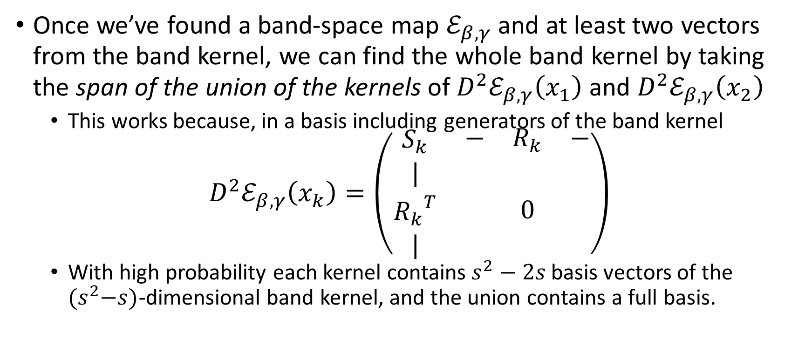
Key Recovery Step 1:
Solving for the whole band kernel.
Once we’ve found a band-space map $ℰ_{β,γ}$ and at least two vectors from the band kernel, we can find the whole band kernel by taking the span of the union of the kernels of $D^{2}ℰ_{β,γ}\left(x_{1}\right)$ and $D^{2}ℰ_{β,γ}\left(x_{2}\right)$
  This works because, in a basis including generators of the band kernel
$$D^{2}ℰ_{β,γ}\left(x_{k}\right)=\left(\begin{matrix}S_{k} & \begin{matrix}− & R_{k} & −\end{matrix} \\ \begin{matrix}| \\ {R_{k}}^{T} \\ |\end{matrix} & 0\end{matrix}\right)$$
  With high probability each kernel contains $s^{2}−2s$ basis vectors of the ${(s}^{2}−s)$-dimensional band kernel, and the union contains a full basis.

Slide 19
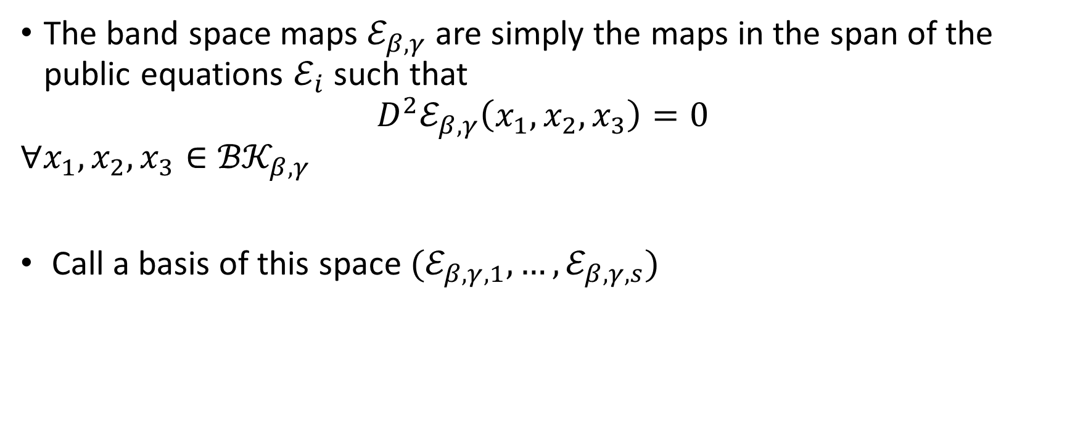
Key Recovery Step 2:
Solving for the whole band space
The band space maps $ℰ_{β,γ}$ are simply the maps in the span of the public equations $ℰ_{i}$ such that
$$D^{2}ℰ_{β,γ}\left(x_{1},x_{2},x_{3}\right)=0$$
$$∀x_{1}, x_{2},x_{3}∈{ℬ𝒦}_{β,γ}$$
Call a basis of this space $(ℰ_{β,γ,1},…,ℰ_{β,γ,s})$

Slide 20

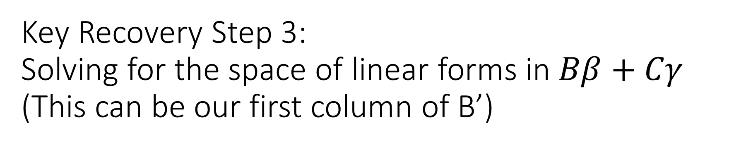
Key Recovery Step 3:
Solving for the space of linear forms in $Bβ+Cγ$
(This can be our first column of B’)
These are simply the space of linear forms $v$ such that
$$v(x)=0$$
$$∀x∈{ℬ𝒦}_{β,γ}$$
Call a basis of this space $(v_{1},…,v_{s})$

Slide 21
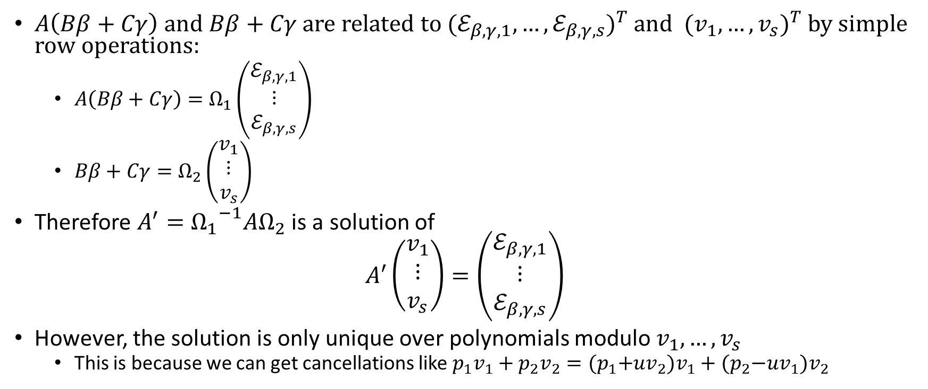

Key Recovery Step 4:
Solving for $A^{′}$ (mod $v_{1},…,v_{s}$)
$A\left(Bβ+Cγ\right)$ and $Bβ+Cγ$ are related to ${(ℰ_{β,γ,1},…,ℰ_{β,γ,s})}^{T}$ and ${(v_{1},…,v_{s})}^{T}$ by simple row operations:
  $A\left(Bβ+Cγ\right)=Ω_{1}\left(\begin{matrix}ℰ_{β,γ,1} \\ ⋮ \\ ℰ_{β,γ,s}\end{matrix}\right)$
  $Bβ+Cγ=Ω_{2}\left(\begin{matrix}v_{1} \\ ⋮ \\ v_{s}\end{matrix}\right)$
Therefore $A^{′}={Ω_{1}}^{−1}AΩ_{2}$ is a solution of
$$A′\left(\begin{matrix}v_{1} \\ ⋮ \\ v_{s}\end{matrix}\right)=\left(\begin{matrix}ℰ_{β,γ,1} \\ ⋮ \\ ℰ_{β,γ,s}\end{matrix}\right)$$
However, the solution is only unique over polynomials modulo $v_{1},…,v_{s}$
  This is because we can get cancellations like $p_{1}v_{1}+p_{2}v_{2}={(p}_{1}+uv_{2})v_{1}+{(p}_{2}−uv_{1})v_{2}$

Slide 22
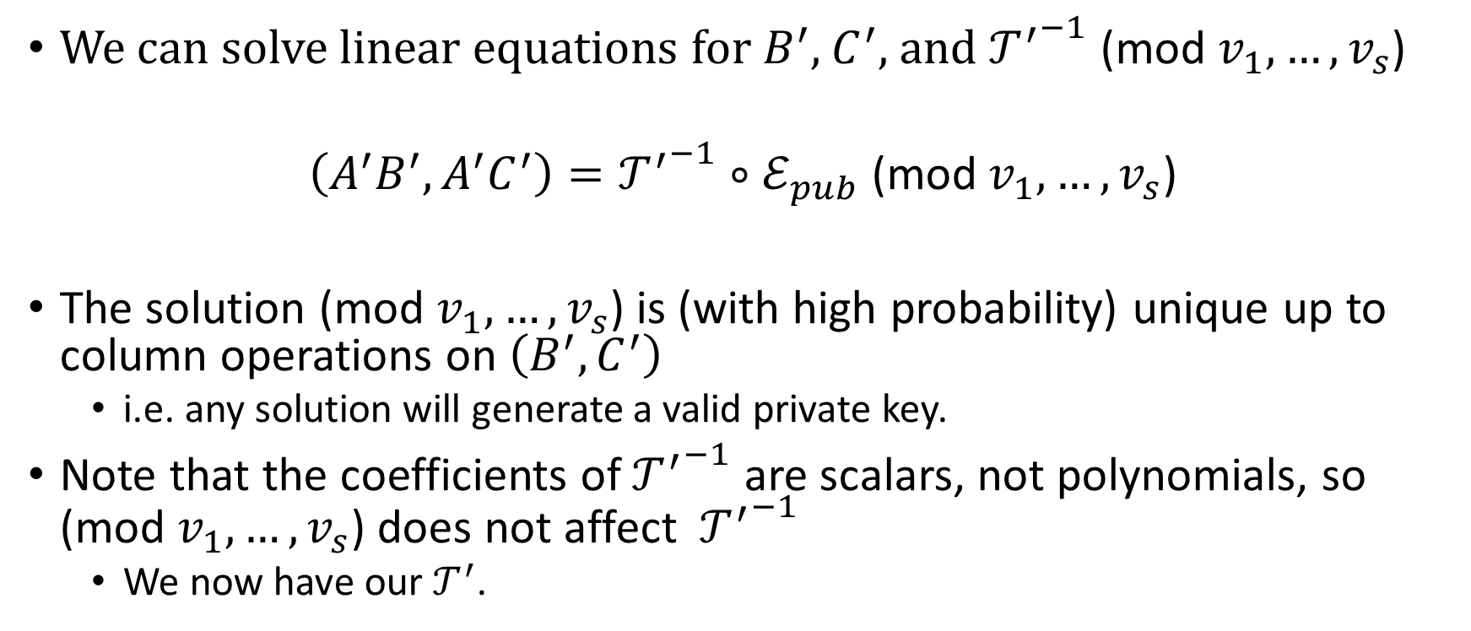
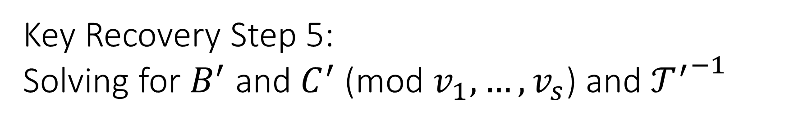
Key Recovery Step 5:
Solving for $B^{′}$ and $C^{′}$ $\text{(}\text{mod} v_{1},…,v_{s}\text{)}$ and ${𝒯^{′}}^{−1}$
We can solve linear equations for $B^{′}$, $C^{′}$, and ${𝒯^{′}}^{−1}$ (mod $v_{1},…,v_{s}$)
$$\left(A^{′}B^{′}, A^{′}C^{′}\right)={𝒯^{′}}^{−1}∘ℰ_{pub} \text{(}\text{mod} v_{1},…,v_{s}\text{)}$$
The solution $\text{(}\text{mod} v_{1},…,v_{s}\text{)}$ is (with high probability) unique up to column operations on $\left(B^{′}, C^{′}\right)$
  i.e. any solution will generate a valid private key.
Note that the coefficients of ${𝒯^{′}}^{−1}$ are scalars, not polynomials, so $\text{(}\text{mod} v_{1},…,v_{s}\text{)}$ does not affect ${𝒯^{′}}^{−1}$
  We now have our $𝒯^{′}$.

Slide 23
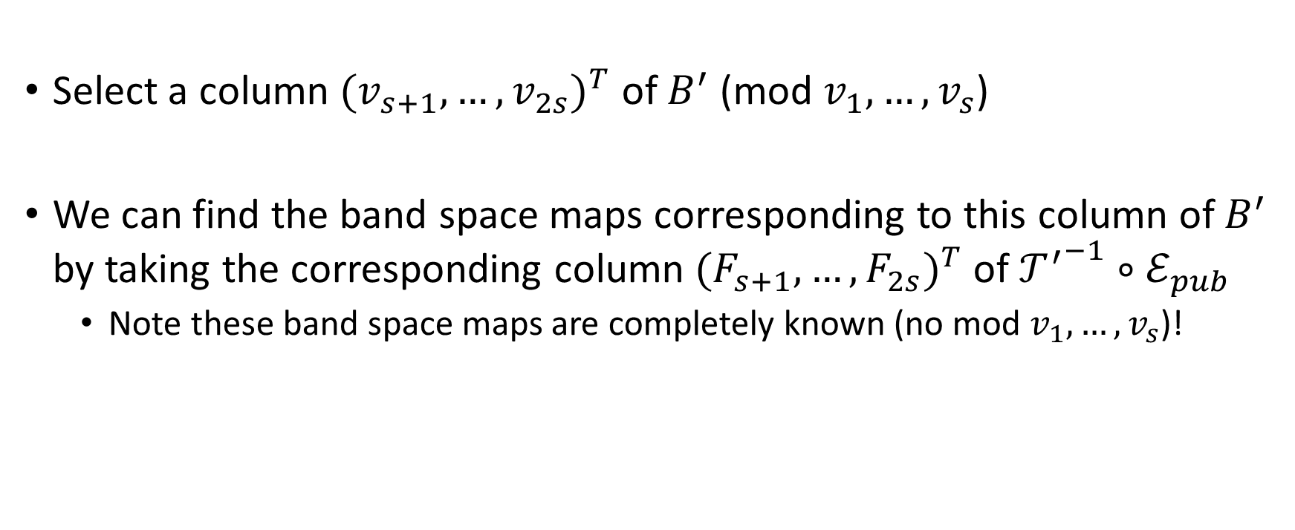
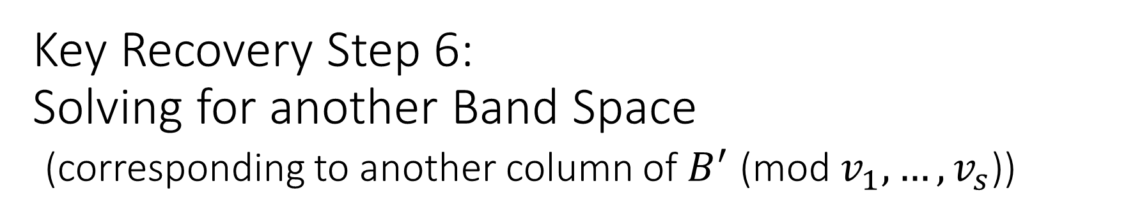
Key Recovery Step 6:
Solving for another Band Space
(corresponding to another column of $B^{′}$ (mod $v_{1},…,v_{s}$))
Select a column ${(v_{s+1},…,v_{2s})}^{T}$ of $B^{′}$ (mod $v_{1},…,v_{s}$)
We can find the band space maps corresponding to this column of $B^{′}$ by taking the corresponding column ${(F_{s+1},…,F_{2s})}^{T}$ of ${𝒯^{′}}^{−1}∘ℰ_{pub}$
  Note these band space maps are completely known (no mod $v_{1},…,v_{s}$)!

Slide 24
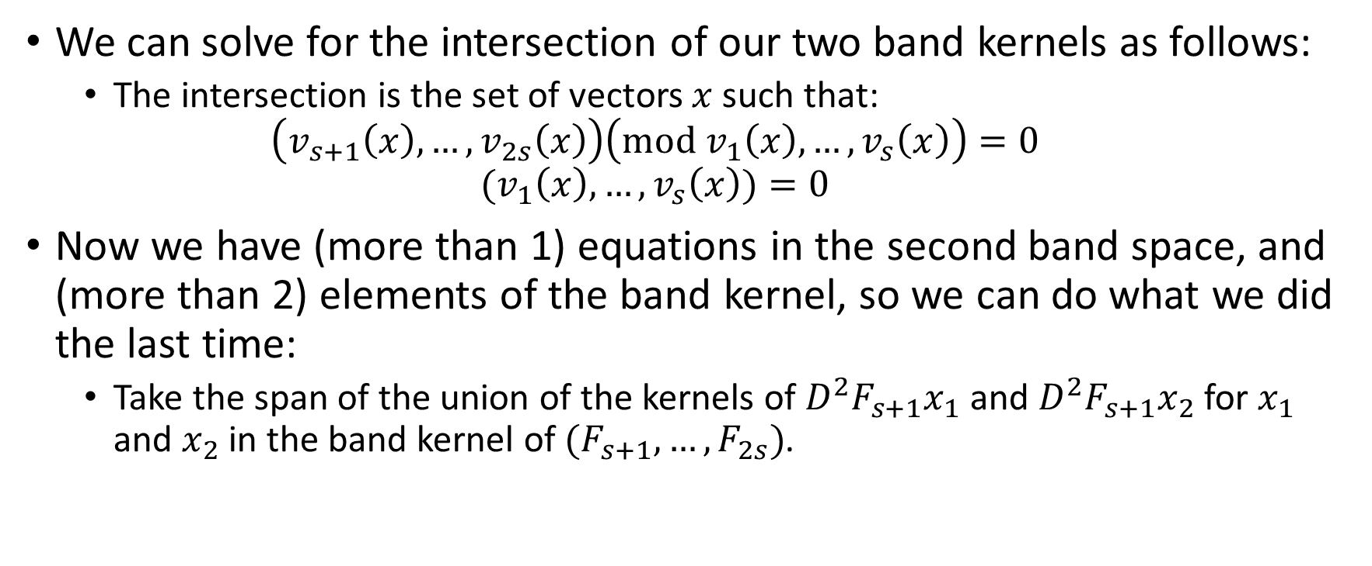
Key Recovery Step 7:
Solving for the Band Kernel
(For the Band Space we found in Step 6)
We can solve for the intersection of our two band kernels as follows:
  The intersection is the set of vectors $x$ such that:
  $$\left(v_{s+1}\left(x\right),…,v_{2s}\left(x\right)\right)\left(mod v_{1}\left(x\right),…,v_{s}\left(x\right)\right)=0$$
  $${(v}_{1}\left(x\right),…,v_{s}\left(x\right))=0$$
Now we have (more than 1) equations in the second band space, and (more than 2) elements of the band kernel, so we can do what we did the last time:
  Take the span of the union of the kernels of $D^{2}F_{s+1}x_{1}$ and $D^{2}F_{s+1}x_{2}$ for $x_{1}$ and $x_{2}$ in the band kernel of $(F_{s+1},…,F_{2s})$.

Slide 25
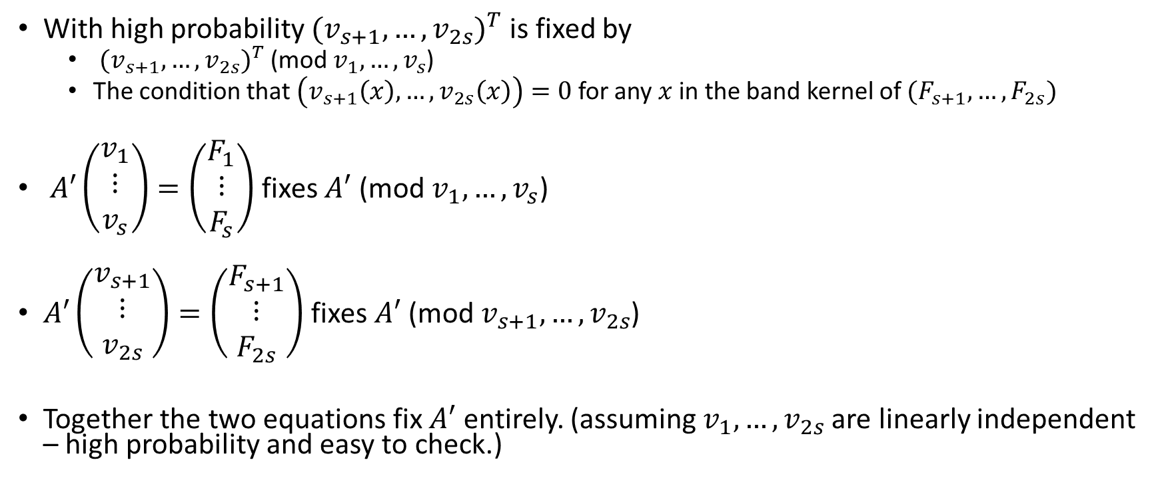

Key Recovery Step 8:
Solving for the Rest of $A’$
With high probability ${(v_{s+1},…,v_{2s})}^{T}$ is fixed by
  ${(v_{s+1},…,v_{2s})}^{T}$ (mod $v_{1},…,v_{s}$)
  The condition that$\left(v_{s+1}\left(x\right),…,v_{2s}\left(x\right)\right)=0$ for any $x$ in the band kernel of $(F_{s+1},…,F_{2s})$
$A′\left(\begin{matrix}v_{1} \\ ⋮ \\ v_{s}\end{matrix}\right)=\left(\begin{matrix}F_{1} \\ ⋮ \\ F_{s}\end{matrix}\right)$ fixes $A′$ (mod $v_{1},…,v_{s}$)
$A′\left(\begin{matrix}v_{s+1} \\ ⋮ \\ v_{2s}\end{matrix}\right)=\left(\begin{matrix}F_{s+1} \\ ⋮ \\ F_{2s}\end{matrix}\right)$ fixes $A′$ (mod $v_{s+1},…,v_{2s}$)
Together the two equations fix $A′$ entirely. (assuming $v_{1},…,v_{2s}$ are linearly independent – high probability and easy to check.)

Slide 26


Key Recovery Step 9:
Solving for the rest of $B′$ and $C′$
Same equation as before without the (mod $v_{1},…,v_{s}$)
$$\left(A^{′}B^{′}, A^{′}C^{′}\right)={𝒯^{′}}^{−1}∘ℰ_{pub}$$

Slide 27
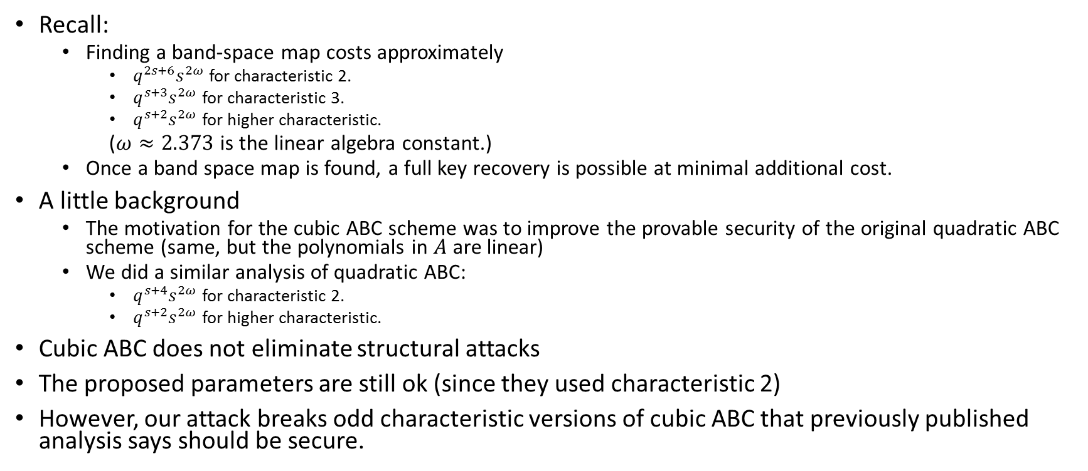
How bad is the attack
Recall:
  Finding a band-space map costs approximately
    $q^{2s+6}s^{2ω}$ for characteristic 2.
    $q^{s+3}s^{2ω}$ for characteristic 3.
    $q^{s+2}s^{2ω}$ for higher characteristic.
  ($ω≈2.373$ is the linear algebra constant.)
  Once a band space map is found, a full key recovery is possible at minimal additional cost.
A little background
  The motivation for the cubic ABC scheme was to improve the provable security of the original quadratic ABC scheme (same, but the polynomials in $A$ are linear)
  We did a similar analysis of quadratic ABC:
    $q^{s+4}s^{2ω}$ for characteristic 2.
    $q^{s+2}s^{2ω}$ for higher characteristic.
Cubic ABC does not eliminate structural attacks
The proposed parameters are still ok (since they used characteristic 2)
However, our attack breaks odd characteristic versions of cubic ABC that previously published analysis says should be secure.

Slide 28
Thank You!

